Slide 1



Aurora
Robotics
AERIAL
ROBOTICS
WEEK 3 OF 8 · AERIAL ROBOTICS
Mechanics, Control and State Estimation
Aurora Robotics
O. C. Kogo, O. O. Egharevba
Run into
The UNKNOWN

Slide 2
‹#›
‹#›
Aurora
Robotics
AERIAL
ROBOTICS
OUTLINE
Out-line
  How flight is generated
  Newtonian Mechanics
  Open loop and Closed loop Control
  PID
  State Estimation
Run into
The UNKNOWN

Slide 3
‹#›
‹#›
Aurora
Robotics
AERIAL
ROBOTICS
OVERVIEW
Overview
  This week will cover rudimentary classical mechanics from a conceptual point of view, which is very important for understanding drone kinematics.
  It will also cover rudimentary control theory.
Run into
The UNKNOWN

Slide 4
‹#›
‹#›
‹#›
Aurora
Robotics
AERIAL
ROBOTICS
Newtonian Mechanics
  There are a few key terms to be unambiguously understood first:
  Force: A force is a push or pull that changes the velocity of an object.
  Inertia: The natural tendency for an object to resist change to its motion.
  Torque: This is the rotational equivalent of a linear force. It is a twisting or turning force that causes an object to rotate.
  Moment of inertia: An object's resistance to changes in its rotational motion.
  Momentum: the measure of how much motion an object has, calculated as the product of its mass and velocity. This can be thought of how difficult it is to 'stop' a moving object.
Run into
The UNKNOWN

Slide 5
Aurora
Robotics
AERIAL
ROBOTICS
Newtonian Mechanics Contd.
  Newtonian mechanics describes the motion of objects by explicitly considering the forces and torques acting on them.
  Newtonian mechanics is built on top of Newton's laws of motion.
  We consider a quadcopter in flight. The quadcopter must continually produce lift to counter its weight.
Run into
The UNKNOWN

Slide 6
Aurora
Robotics
AERIAL
ROBOTICS
BERNOULLI'S PRINCIPLE
Flight Generation
  In a fluid flow, the pressure and velocity of a fluid remains constant.
  In fixed-wing VTOLS, this can be used to explain how the wings generate lift.
  As air flows around a wing, the wing's shape and angle of attack cause the airflow to accelerate and change direction.
  This creates a pressure difference between the upper and lower surfaces of the wing, resulting in an upward aerodynamic force called lift.
Run into
The UNKNOWN
Notes:
in point one, clarify that this holds under only some assumptions

Slide 7
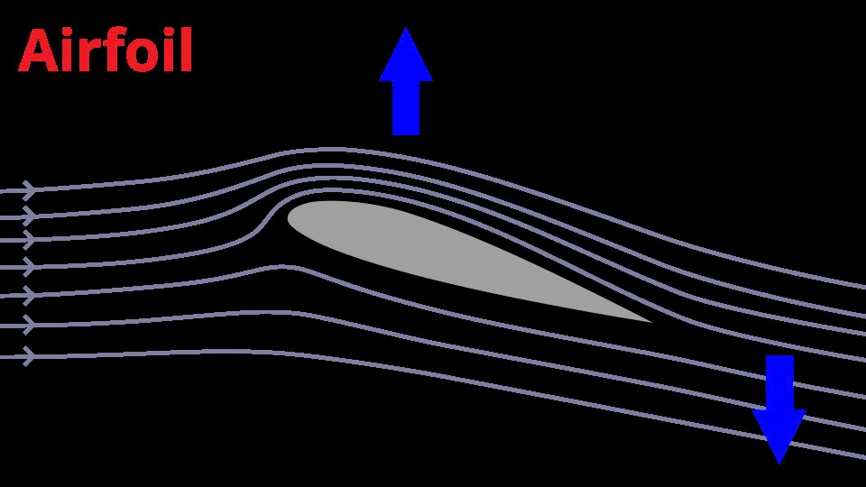
Aurora
Robotics
AERIAL
ROBOTICS
Lift Generation
Run into
The UNKNOWN
Notes:
‹#›

Slide 8
Aurora
Robotics
AERIAL
ROBOTICS
CONTROL
Open Loop and Closed Loop Control
  Control engineering is the design of systems that make physical processes behave in a desired way.
  There are 2 broad categories of control engineering: Open loop and closed loop control.
Open Loop Control | Closed Loop Control
Control without feedback | Uses a sensor to get feedback
Cheaper to implement | More costly to implement
Good when there's a good model or the system is sufficiently simple | Good when there are uncertainties in parameters and for more complex systems
Run into
The UNKNOWN

Slide 9
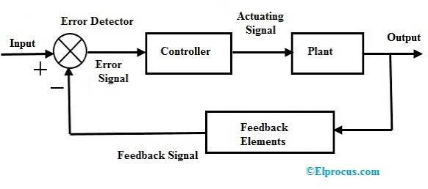
Aurora
Robotics
AERIAL
ROBOTICS
CONTROL
Closed Loop Control Systems
  Most of control engineering happens in closed loop control.
Run into
The UNKNOWN

Slide 10

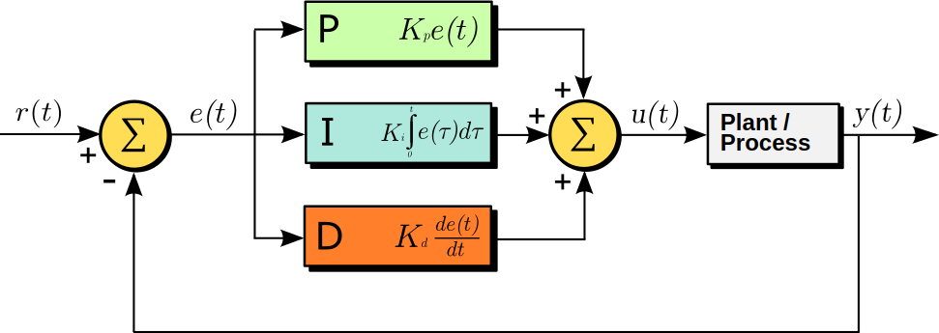
Aurora
Robotics
AERIAL
ROBOTICS
PID
PID Control
  Remember the previous diagram, there was a box named 'controller'.
  To explain PID control, we must take each part apart using the same example:
  Imagine you are flying a drone and want to hover at a specific height.
  You can control the angular velocity of the motors, which controls the lift.
  There are two important forces in this simple example- the drone's weight acting downward and the lift acting upward.
  We define the error as the difference between the drone's current height and the desired height.
Run into
The UNKNOWN
Notes:
This is where the controller model lives- PID, LQR, MPC,Lyapunov Functions, frequency response methods etc..

Slide 11
Aurora
Robotics
AERIAL
ROBOTICS
PID
PID - Proportional
  Taking P- the Proportional term only- we multiply the error by the proportional gain (Kp) and send that as output to the motors.
  This works well in getting the drone close to the desired value, but the error vanishes at the desired, leading to the output being zero.
  The drone requires a set motor velocity to hover at a particular height.
  But the closer it gets to the desired height past a certain point, the more the error tends to 0 and the output also becomes 0.
  This leads to the drone hovering at a height that produces an error high enough to produce an output that can keep the drone hovering.
  This is called steady-state error and is almost inevitable when using only the proportional term.
Run into
The UNKNOWN

Slide 12
Aurora
Robotics
AERIAL
ROBOTICS
PID
PID Control - Derivative
  Let's say we want to decrease the the response time.
  We increase the proportional gain to produce stronger commands. But then the drone inertia makes it overshoot our target. This leads to oscillatory behaviour.
  To counter this oscillation, we introduce the derivative. The derivative gain (Kd) is multiplied by the rate of change of the error.
  This gives us a way to shape the response according to how fast the error is changing.
  The derivative term then acts as a 'dampener' to dampen oscillatory behaviour, as it reduces the command being sent as the drone approaches the destination.
  The derivative term prevents overshoot in situations where little or 0 overshoot is critical.
Run into
The UNKNOWN

Slide 13
Aurora
Robotics
AERIAL
ROBOTICS
PID
PID Control - Integral
  Now we have a drone that flies close to its target without overshooting, in a timely manner.
  We have one more problem to solve: the drone doesn't hover at the set point.
  It has a constant error called steady-state error.
  By integrating the error over time, and multiplying that by the integral gain (Ki), we get the integral term.
  The integral term accumulates the error and produces commands based on the accumulated error over time.
  This leads to a gradual correction of the steady-state error over time. Allowing the drone to hover at the desired position.
Run into
The UNKNOWN

Slide 14
Aurora
Robotics
AERIAL
ROBOTICS
PID
PID Controllers - Tuning
  Pid controllers have a few different tuning methods like the Zeigler-Nichols tuning method and software optimization methods.
  But it is usually sufficient to tune manually via trial-and-error for non-critical systems.
  A quick refresher which helps with tuning:
  P term- used for generating commands proportional to error. Leaves steady-state error.
  I term- used to cancel out steady-state error.
  D term- used to smooth out oscillations and overshoot caused by mechanical dynamics.
Run into
The UNKNOWN

Slide 15
Aurora
Robotics
AERIAL
ROBOTICS
STATE ESTIMATION
State Estimation
  State estimation is the task of estimating a robot/system's position from its sensor measurements and system model.
  The simplest state estimation algorithm is dead-reckoning.
  Dead-reckoning is integrating the movements of the robot to get its position over time.
  Dead reckoning isn't ideal as it accumulates error due to sensor drift over time and doesn't model disturbances or noise.
  Other techniques are Kalman filters, particle filters, Luenberger obersevers, etc..
Run into
The UNKNOWN

Slide 16
Aurora
Robotics
AERIAL
ROBOTICS
STATE ESTIMATION
State Estimation – Kalman Filters
  Kalman filters are used extensively in aerial robotics.
  These track the state in a stochastic manner, tracking the most probable state (e.g. position and velocity) and its uncertainty.
  A Kalman filter estimates a robot's state when both the robot's motion and its sensor measurements are uncertain.
  It does this in two steps: an update and a prediction step.
Run into
The UNKNOWN

Slide 17
Aurora
Robotics
AERIAL
ROBOTICS
STATE ESTIMATION
Kalman Filters Contd.
  Prediction: Where do we expect the robot to be based on its previous state and motion?
  Measurement: What does a sensor tell us about the robot's current state?
  High prediction uncertainty means the observer would trust the measurement more.
  High measurement uncertainty means the observer would trust the prediction more.
  An Example: Wheel odometry predicts that the robot is at x=5.0m, but GPS measures x=5.4m.
  If the odometry is more reliable than the GPS, the Kalman filter may estimate x≈5.1m rather than simply choosing either value.
Run into
The UNKNOWN
Notes:
‹#›

